Slide 1

SplicingFactory—splicing diversity analysis for transcriptome data
Bioinformatics Algorithms
Benedek Dankó, Péter Szikora, Tamás Pór, Alexa Szeifert, Endre Sebestyén
2021
Students: Zahra Ahmad Nezhad, Samie Baniasadi
January 2022

Slide 2
What is splicingFactory?
They created an R package called SplicingFactory to meet different criteria,
They calculated RNA isoforms and examined them under different conditions.
SplicingFactory R :
The SplicingFactory R package uses transcript-level expression values to analyze splicing diversity based on various statistical measures, like Shannon entropy or the Gini index.

Slide 3
Items that have been tested using packages on a variety of isoforms:
the effect of RNA-seq quantification tools
quantification uncertainty
gene expression levels
isoform numbers

Slide 4
alternative splicing
is well-known and described in most eukaryotic organisms
expands the RNA repertoire of most genes

Slide 5
outline
Materials and methods
dataset processing
Comparison
Implementation
Results

Slide 6
Myelodysplastic syndrome dataset processing
data from SRA (SRP133442, SRP149374) using SRA-tools
they quantified transcript-level expression using Kallisto and Salmon and the full GENCODE v34 transcriptome annotation.
Salmon-SAF was run both in alignment-based using the STAR alignments and mapping-based mode using a decoy-aware transcriptome index.
they run the tool with 100 bootstraps, the unstranded paired-end library option and the additional -seqBias and -gcBias parameters.

Slide 7
Comparison of Kallisto, Salmon and Salmon-SAF results
they selected the 17 control samples from the SRP133442 dataset.
calculated the normalized naive-entropy and Gini-index for all genes.
they selected all genes with non-NA diversity values and calculated their Spearman correlation.

Slide 8
Performance benchmarks
using a single core on a server with Intel® Xeon® Gold 4118 2.30 GHz CPU type, a total of 157 GB memory and Ubuntu 18.04.5 LTS operating system.
they used the Salmon-based quantification for the benchmarks.
Using a fixed number of 60 669 starting genes, they increased the sample number from 10 to 130 using steps of 10, 20, 40, 60, 80, 100 and 130 for the same calculations.

Slide 9
Comparison to other tools
splicehetero
ran SpliceHetero with parameters -slb True and -prn 17
To prepare the input data keeping only those splice junctions that appear in the STAR index sjdbList.fromGTF.out.tab file
converted the filtered STAR junction files
ran SpliceHetero on these sorted BED files
SEVA
ran SEVA in RStudio Server to FALSE
To prepare the input data we first performed RPM normalization on the STAR splice junction files

Slide 10
Comparison to other tools
whippet
ran Whippet with default parameters
To prepare the input data, we converted the raw fastq files to have only a single ‘+’ character on every third line
using Whippet’s whippet-index.jl script, created an index file based on the GENCODE v34 transcriptome annotation gtf file, and ran Whippet’s quantification algorithm with the whippet-quant.jl script with the additional -biascorrect parameter

Slide 11
SF3B1 differential diversity and enrichment analysis
analyzed the SRP149374 dataset
compared the MDS samples without any known mutation to MDS samples with known SF3B1 somatic mutations
calculated the normalized naive-entropy, normalized Laplace-entropy and Gini-index using the Salmon-based quantification
compared the SF3B1 mutated and SF3B1 wild-type samples using Wilcoxon-test and performed P-value adjustment with the Benjamini–Hochberg method.
performed enrichment analysis using the significant genes (|mean difference| > 0.1 and adjusted P-value <0.05) separately with either a mean diversity increase or decrease between the SF3B1 mutant and SF3B1 wild-type groups
used the bone marrow marker gene sets originating

Slide 12
Implementation
the package calculates a diversity value for each gene in each sample, using splicing isoform expression values.
calculates differential diversity results between conditions.

Slide 13
Association of diversity metrics
The Gini-index shows an opposing pattern compared to all others.
The nonnormalized naive- and Laplace-entropy, besides the Simpson-index and the inverse Simpson-index shows a clear association with isoform number.
the strongly biased pattern for the normalized Laplace-entropy is again the result of the +1 pseudocount, as all genes with only zero or very low isoform expression levels are given an expression of ∼1, leading to the maximum possible entropy of 1.

Slide 14
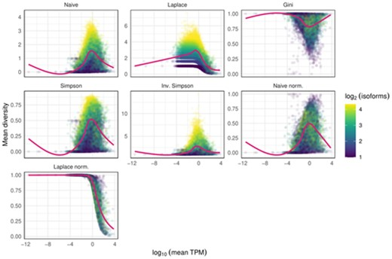

Slide 15
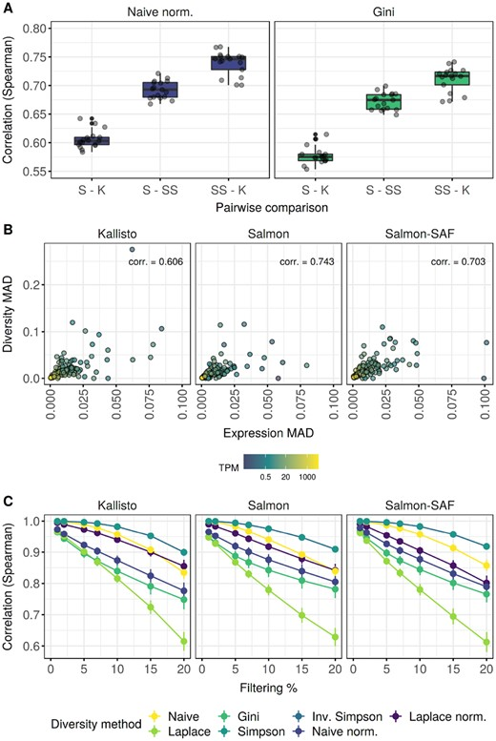

Slide 16
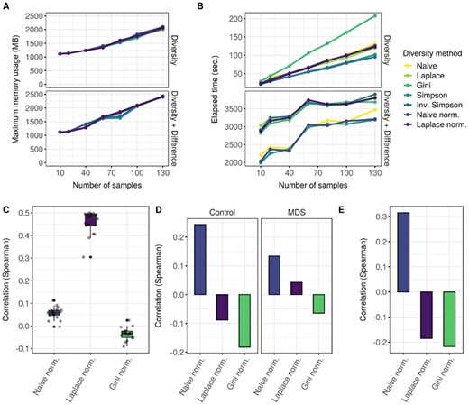
Performance benchmarks

Slide 17
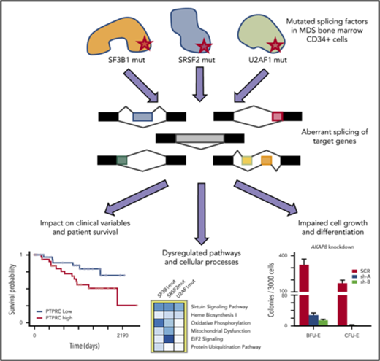

Slide 18
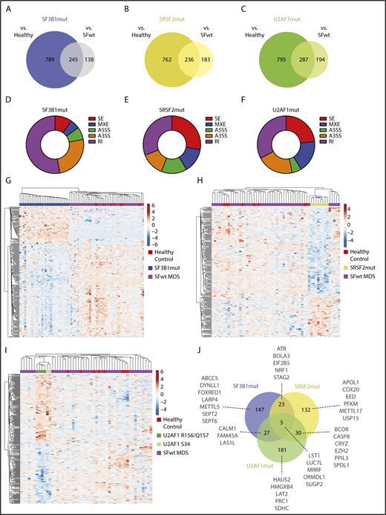

Slide 19
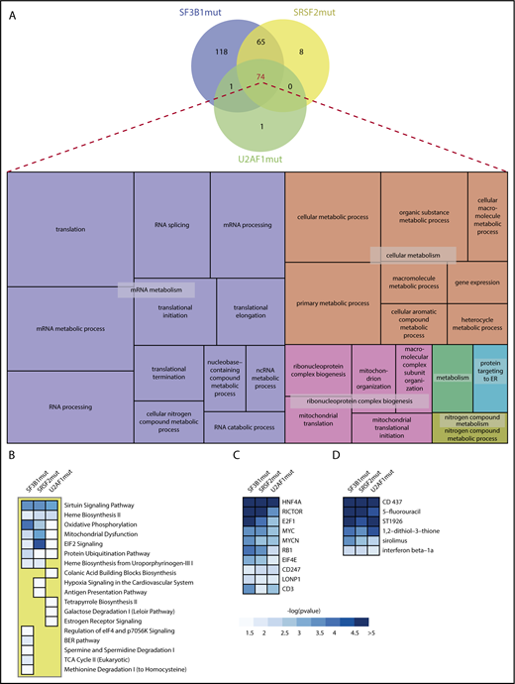

Slide 20
List of aberrant splicing events, identified in SF3B1mut MDS, significantly correlated with a clinical variable
Event ID | Gene | Event type | Chr | Strand | Start position | End position | Spearman correlation variable | cor_estimate | P | adj.P
6795 | PARVG | A3SS | 22 | + | 44582456 | 44583758 | BM blast % | 0.58 | 4.38E-07 | .003031
5420 | RPRD1A | RI | 18 | − | 33605560 | 33607038 | BM blast % | 0.58 | 6.21E-07 | .004292
3146 | DOM3Z | RI | 6 | − | 31938382 | 31938924 | ANC | −0.57 | 1.00E-06 | .006916
12280 | CXXC1 | SE | 18 | − | 47811694 | 47811721 | ANC | −0.56 | 1.28E-06 | .00888

Slide 21
3305 | AP1G2 | RI | 14 | − | 24031170 | 24031624 | ANC | −0.56 | 1.68E-06 | .011579
2362 | SNRPN | A3SS | 15 | + | 25219434 | 25219603 | ANC | −0.55 | 3.14E-06 | .021689
5460 | TCEA2 | A3SS | 20 | + | 62703210 | 62703294 | ANC | 0.54 | 3.24E-06 | .022393
6627 | NICN1 | A3SS | 3 | − | 49462381 | 49462579 | Plt | −0.54 | 3.80E-06 | .026281
6153 | ABCC5 | A3SS | 3 | − | 183703091 | 183703243 | ANC | −0.54 | 4.23E-06 | .029229
518 | ERCC3 | RI | 2 | − | 128046912 | 128047400 | ANC | −0.54 | 4.71E-06 | .032551
2359 | SNRPN | A3SS | 15 | + | 25219457 | 25219603 | ANC | −0.54 | 5.02E-06 | .03468

Slide 22
7563 | PPOX | A3SS | 1 | + | 161137128 | 161137276 | ANC | 0.53 | 5.99E-06 | .041411
4975 | GPR108 | A3SS | 19 | − | 6730997 | 6731122 | ANC | −0.53 | 6.43E-06 | .044443
5816 | PSTPIP1 | A3SS | 15 | + | 77328142 | 77328276 | ANC | −0.53 | 6.49E-06 | .044832
4728 | NICN1 | RI | 3 | − | 49462381 | 49462871 | Plt | −0.53 | 6.75E-06 | .046655

Slide 23
Genes with isoforms that significantly predicted survival in MDS in multivariate models
Gene | Associated splice factor mutation or mutations | Function/pathway | P (multivariate survival)
CAP1 | SRSF2 | Focal adhesion & extracellular exosomes | .0044
PTPRC | U2AF1 (S34) | Focal adhesion & extracellular exosomes | .0093
IFI44 | SRSF2, U2AF1 (S34) | Interferon, extracellular exosomes | .012
IFI44L | U2AF1 (S34) | Interferon, extracellular exosomes | .0086

Slide 24
CD46 | U2AF1 (S34) | Focal adhesion & extracellular exosomes | .039
CRTC2 | SF3B1 | Extracellular exosomes | .035
FCGR2A | U2AF1 (S34) | Extracellular exosomes | .016
PPOX | SF3B1, U2AF1 (R156/Q157) | Heme biosynthesis | .031
AHSA2 | SF3B1 | HSP90 ATPase | .029
DHP5 | SF3B1 | Translation elongation factor 2 modification | .026
MECR | U2AF1 (S34 & R156/Q157) | Mitochondrial reductase | .022

Slide 25
NASP | U2AF1 (S34) | HSP90 binding | .014
PFDN5 | U2AF1 (R156/Q157) | Prefoldin subunit | .042
PABPC4 | U2AF1 (R156/Q157) | NMD mRNA decay | .036

Slide 26
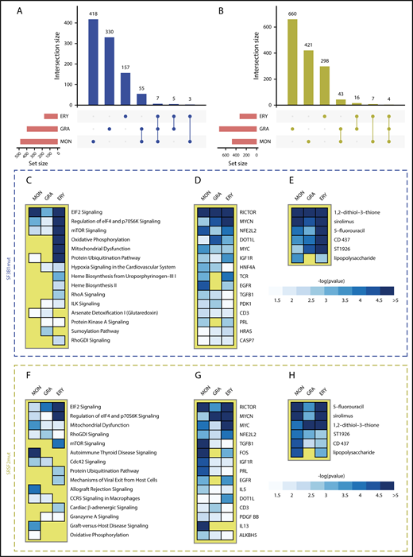

Slide 27
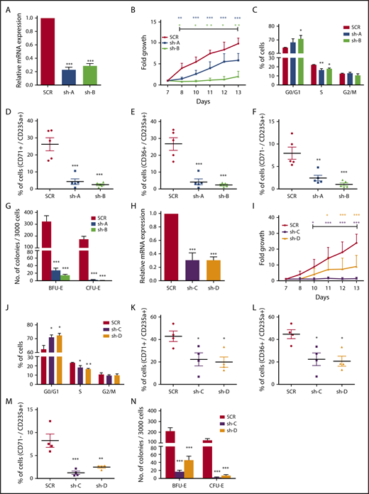

Slide 28
Thank you

